Slide 1
Network Assisted Platooning
Maria, filip, Mikael, Gabriel

Slide 2
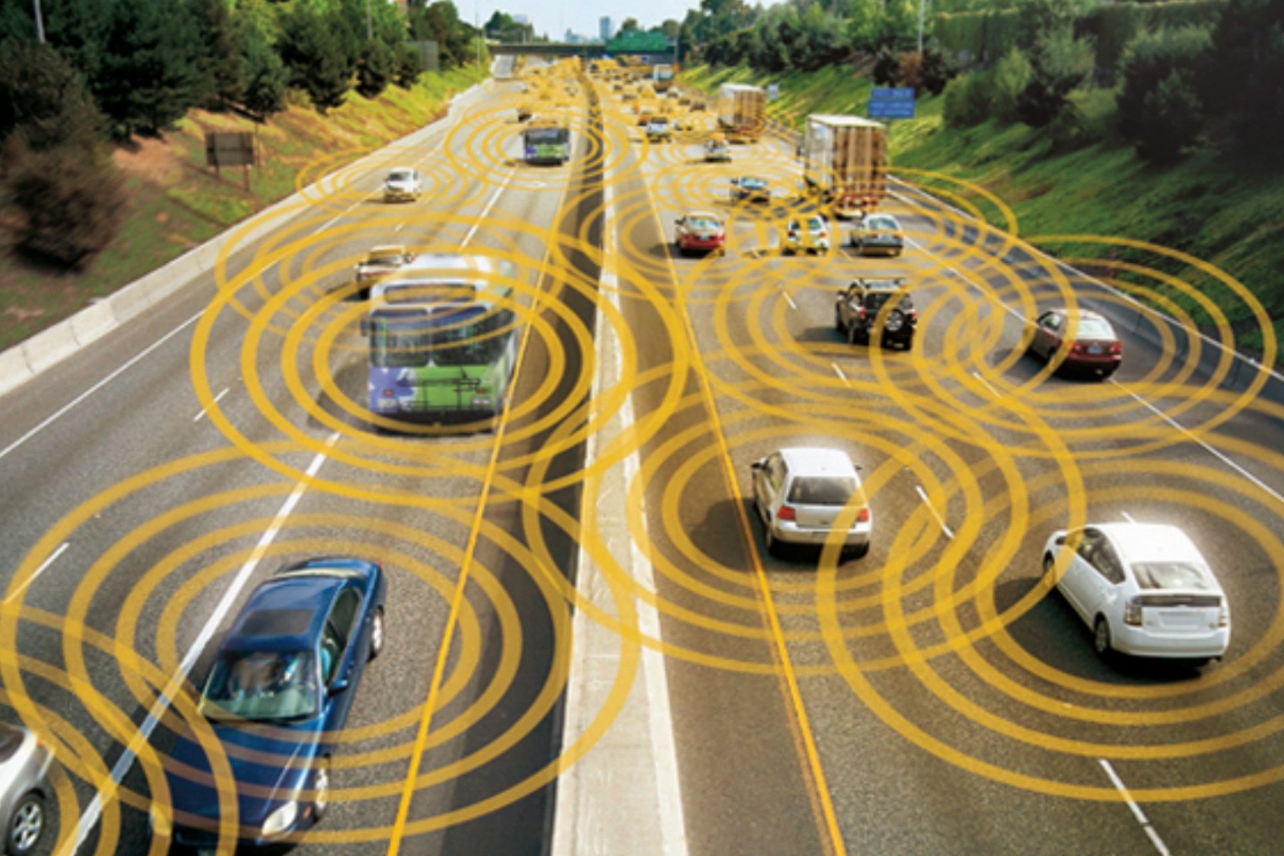
Future
Amount of autonomous vehicles will increase.
Advanced communication technologies.

Slide 3
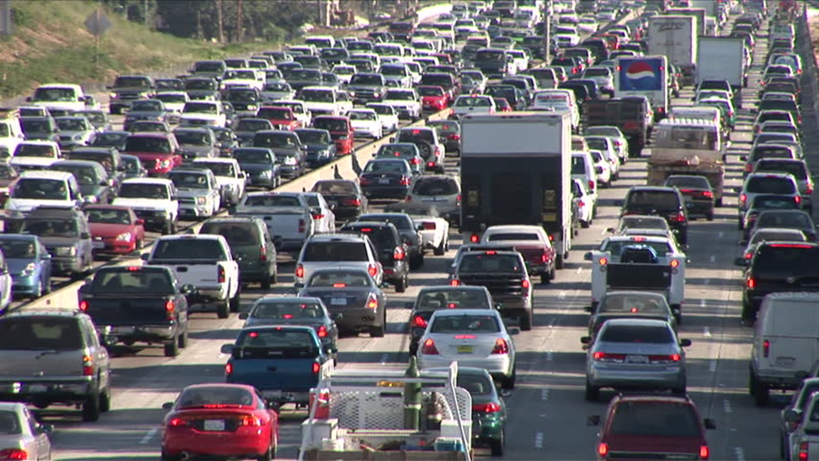
Imagine no traffic
Data generated from the vehicles should be analyzed and shared. Why?
Traffic flow control

Slide 4
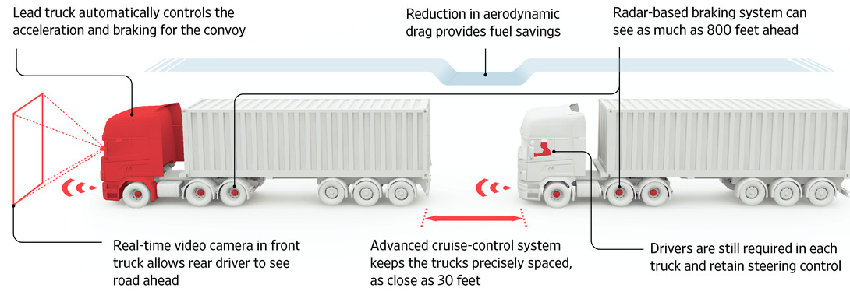
Sustainability
Reducing fuel consumption by drafting.

Slide 5
Centralised control
Control processes are done locally on the vehicles.
Power demanding.
Emerging technologies makes it possible to migrate heavy computations to external servers.
Data can hence be analyzed and shared in a wider range.
Scalability.
Traffic optimisation.

Slide 6
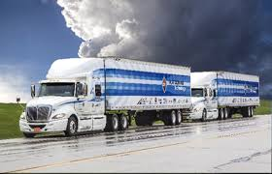
Project description
Platooning with two trucks.
Generation of paths for the trucks to follow.
Controller for the path following.
Controller for the distance regulation.

Slide 7
Communication
ROS, Wifi.
MoCap – publish vehicle position.
Controller on computer subscribes.
Controller output is sent through Wifi to Arduino on truck.

Slide 8
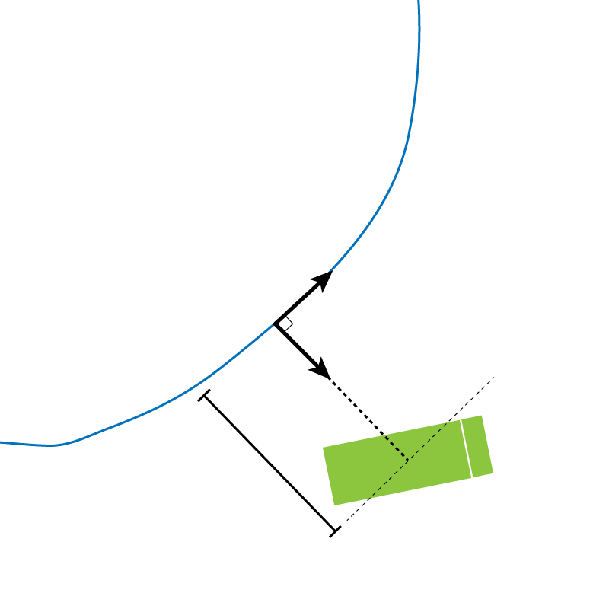
Path tracking
- Frenet frame
- Control orthogonal distance
- Feedback linearization and PID.

Slide 9
PID
PID control has been implemented for distance regulation as well.
The error which is minimized is the relative time difference between the trucks.

Slide 10
Lessons learned
Better model of the truck earlier on.
Looked into other control methods.

